Slide 1
Employees Salary Analysis
using Excel
STUDENT NAME : SINDHU. A
REGISTER NO : 2213211042153
DEPARTMENT : B. Com. (C.S) SHIFT II
COLLEGE : PRESIDENCY COLLEGE (AUTONOMUS)

Slide 2
PROJECT TITLE:
Employees Salary Analysis
Using Excel

Slide 3


AGENDA
Problem Statement
Project Overview
End Users
Our Solution and Proposition
Dataset Description
Modelling Approach
Results and Discussion
Conclusion
3/21/2024 Annual Review

Slide 4

PROBLEM STATEMENT
Identify the problem. Start by pointing out an issue and gathering data.
Put the problem into context. Describe how the problem impacts customers and stakeholders.
Find the root cause.
Describe your ideal outcome.
Propose a solution and outline its benefits

Slide 5

PROJECT OVERVIEW
A project overview is a detailed description of a project's goals and objectives, the steps to achieve these goals, and the expected outcomes. In addition, a project overview enables you to outline the project schedule, budget, necessary resources, and status.

Slide 6

WHO ARE THE END USERS?
End-user is a term used in product development that refers to the person who uses the product. An end-user database is, therefore, a database that is primarily used by a single person. A good example of this type of database is a spreadsheet stored on your local computer if you own a business.

Slide 7

OUR SOLUTION AND ITS VALUE PROPOSITION
A value proposition is a core component of a modern, actionable data and analytics strategy. Most data and analytics strategies define goals and discuss a roadmap but lack an explicit description of their value proposition(s). However, data and analytics initiatives are not necessarily self-evident.

Slide 8
Dataset Description
A Data Set is a container that holds the data you upload to Analytics. Data Sets control how uploaded data gets joined with existing data. You configure Data Sets at the Property level. Data Sets must be associated with at least one View, and can be associated with multiple Views.

Slide 9

THE "WOW" IN OUR SOLUTION
Data analytic solutions pull data from the ERP, both strategic (revenue, profit and growth), and operational (daily sales performance), enabling you to conduct in-depth analyses that can deliver high-level insights. With a trusted source of data, you can develop a strategy around data-driven decision making.
3/21/2024 Annual Review
9

Slide 10
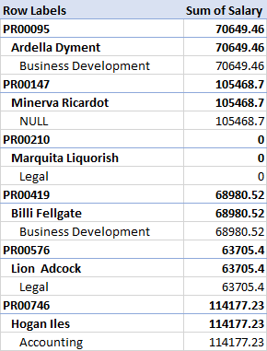
MODELLING
10

Slide 11
RESULTS
11

Slide 12
Conclusion
Data analytics is the science of analyzing raw data to make conclusions about that information. Data analytics help a business optimize its performance, perform more efficiently, maximize profit, or make more strategically-guided decisions.

